Slide 1
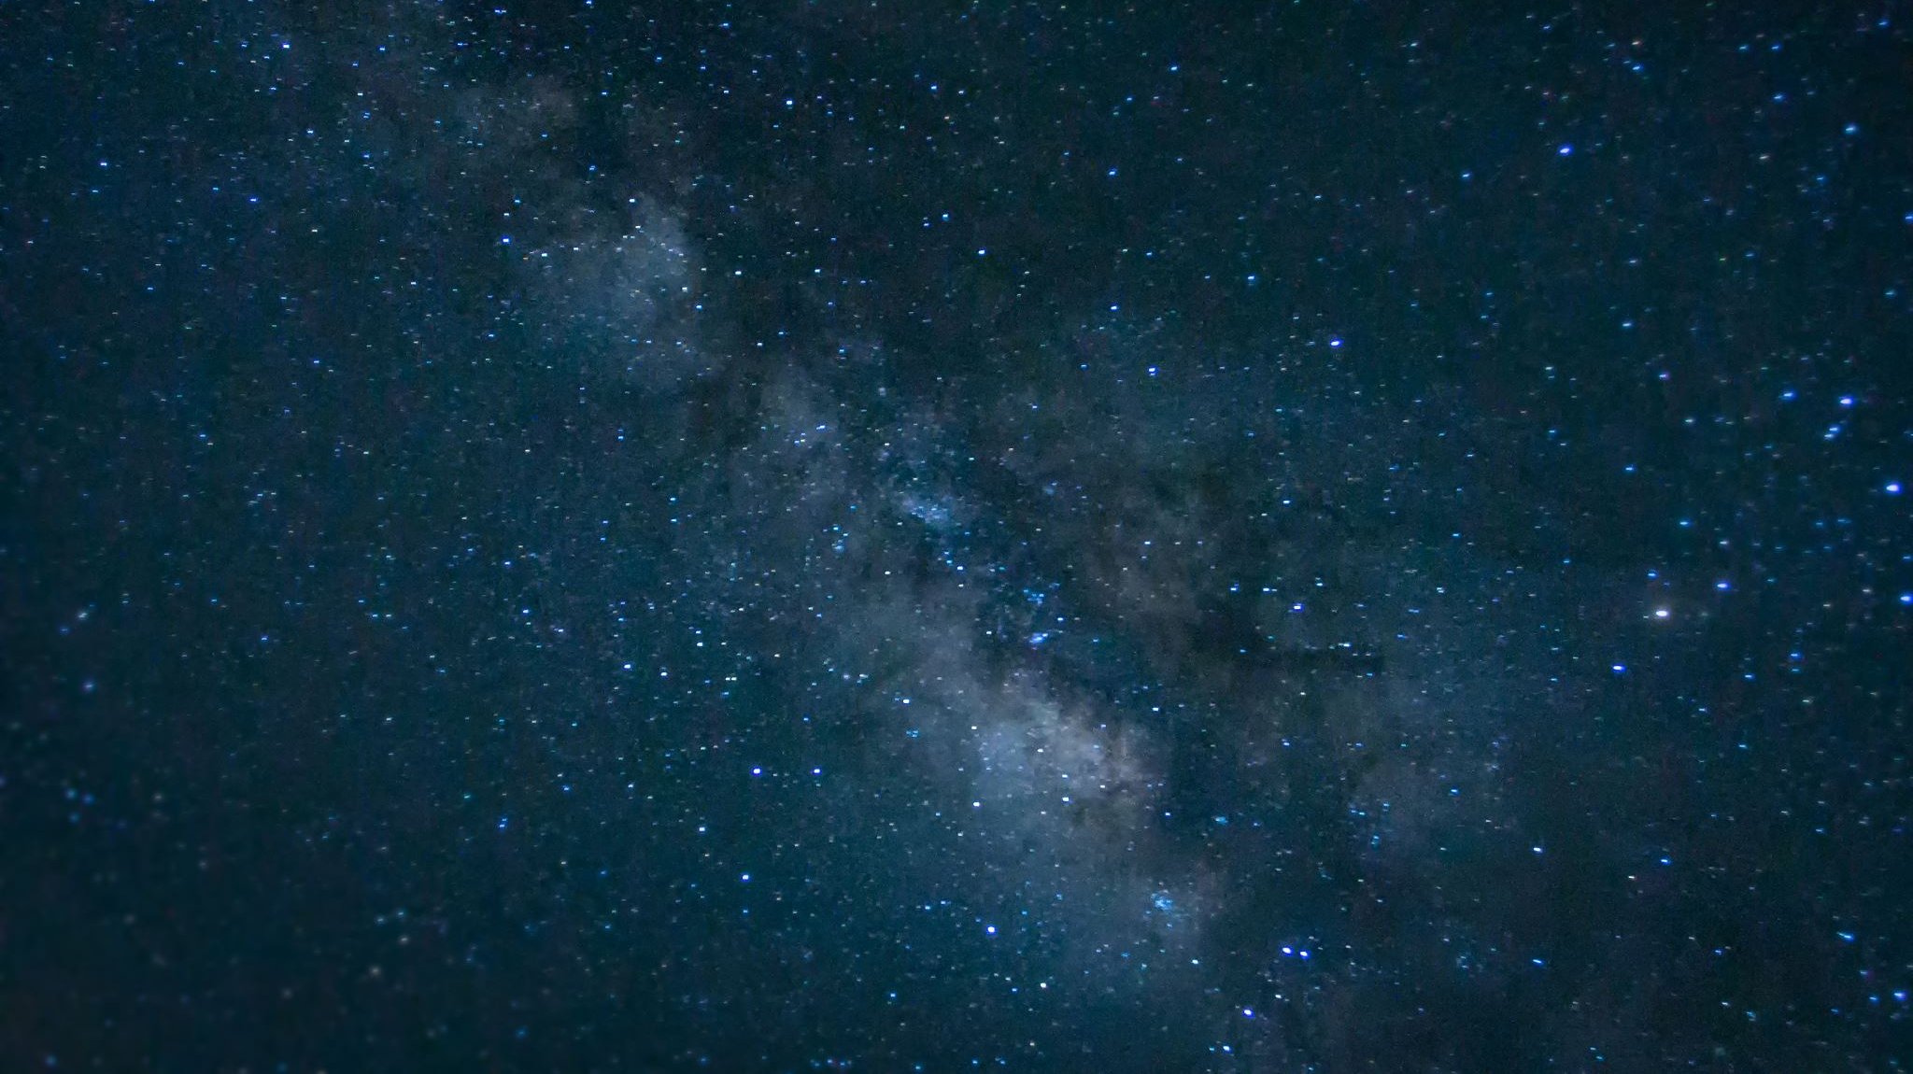
Simulating Realistic Light Curves of Cepheid Variable Stars
CAROLINE KUCZEK ’22
PHYSICS
SENIOR RESEARCH PROJECT
DECEMBER 16, 2021

Slide 2
Introduction
Cepheids are intrinsic variable stars
Variable luminosity: periodic expansion and contraction of outer layers
Period-luminosity direct relationship
Best tool to make extragalactic distance measurements
Gifer.com
Notes:
Cepheids are intrinsic variable stars
Variable luminosity: periodic expansion and contraction of outer layers
Period-luminosity direct relationship
Best tool to make extragalactic distance measurements

Slide 3
Background
Compare Cepheid light curve observations to models
Analyze the variations
More information about Cepheids' physical properties and behavior
Possibly discover other important properties of Cepheids
Space FM
Notes:
Compare Cepheid light curve observations to models
Analyze the variations
More information about Cepheids' physical properties and behavior
Possibly discover other important properties of Cepheids

Slide 4
Motivation
Write code that improves upon the VSP's MESA Cepheid simulation
Make the theoretical model account for the data quality effects on the observed data
Flag data points ROTSE III telescope would not observe due to astrophysical effects
Creating a model will enable more accurate measurements of period changes through comparison to observations
Period changes of Cepheids are one of main contributors to usefulness
Notes:
Write code that improves upon the VSP's MESA Cepheid simulation
Make the theoretical model account for the data quality effects on the observed data
Flag data points ROTSE III telescope would not observe due to astrophysical effects
Creating a model will enable more accurate measurements of period changes through comparison to observations
Period changes of Cepheids are one of main contributors to usefulness

Slide 5
Theory
Cepheids are in the instability strip
Outer layers become unstable and pulsate
unbalanced forces from the pressure caused by radiation outward and the inward gravitational force
Period-Luminosity Equation:
M= – [2.43(log₁₀(P)-1)]-4.05
Notes:
Cepheids are in the instability strip
Outer layers become unstable and pulsate
unbalanced forces from the pressure caused by radiation outward and the inward gravitational force
Period-Luminosity Equation:

Slide 6
Theory
a=altitude
𝛿=declination
𝜙=observer's latitude
𝒉=local sidereal time-right ascension
λ=observer's longitude
Different stars are visible at different times of the year
Altitude of star
Local sidereal time
GST
sin(a) = sin(𝛅)sin(𝝓) + cos(𝛅)cos(h)cos(𝝓)
= GST – λ
≈ (360º (months since March 21)(30.4333))/365.25
Number of hours of darkness per night that observations can be taken
Exact calculation TBD
Calculate duration of night time by calculating sunrise/sunset times
Notes:
Different stars are visible at different times of the year
Altitude of star:
Local sidereal time =
GST approx
The declination and right ascension are basically the coordinates of the star
GST is the distance of the telescope's location from the reference meridian
Number of hours of darkness per night that observations can be taken
Exact calculation TBD
Calculate duration of night time by calculating sunrise/sunset times

Slide 7
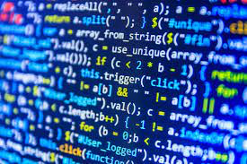
Methods: MESA
MESA: Modules for Experiments in Stellar Astrophysics
Code to model a star’s stellar evolution
Can model Cepheids’ evolution
Techcrunch.com
Mesastar.org
Notes:
MESA: Modules for Experiments in Stellar Astrophysics
Code to model a star’s stellar evolution
Can model Cepheids’ evolution

Slide 8
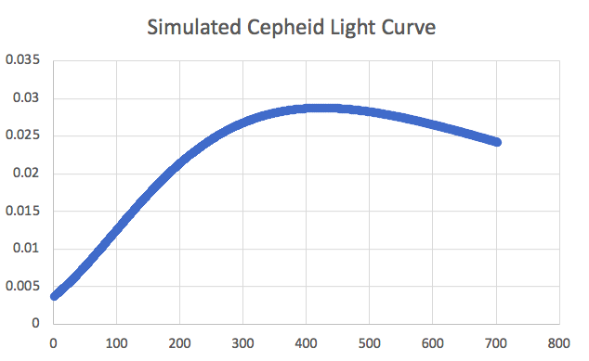
Methods
Input initial parameters of star into MESA
Take MESA output and input to excel
Select input data to use for phot_per_sec.py
Use output in excel to plot photons vs. time (light curve)
rotsehub
Notes:
Input initial parameters of star into MESA
Take MESA output and input to excel
Select input data to use for phot_per_sec.py
Use output in excel to plot photons vs. time (light curve)

Slide 9
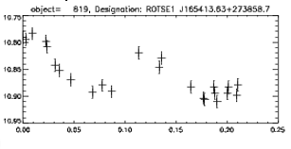
Experiment
Produce Ideal light curve (MESA)
Simulate night duration
Simulate altitude of star
Simulate bad weather
Produce new light curve
Notes:
Produce ideal lightcurve using the output of MESA and photons per sec python script
Then use a series of functions to filter out data points that will not be observed by the telescope
First: simulate the duration of night
Simulate the altitude of the star
Simulate bad weather
Produce the new realistic light curve

Slide 10
Results
3 main modules:
Importobs: import data from MESA and make necessary conversions
Makeobs: simulate bad weather, altitude of the star, simulate night, create new light curve
Outputobs: save output light curve and data to a file
Notes:
3 main modules:
Importobs: import data from MESA and make necessary conversions
Makeobs: simulate bad weather, altitude of the star, simulate night, create new light curve
Outputobs: save output light curve and data to a file

Slide 11
Results: Makeobs
Function: weather
Simulates bad weather by using one random number generator to select the instances of bad weather and a second one to choose the duration of the bad weather
Flags these selected data points
Function: daynight
Calculates duration of darkness per night during different times of year
Flag fraction of data points that would correspond to daylight
Function: abovehorizon
Calculates when the star was visible to the telescope
Flags points corresponding to times of year when star is below horizon
Notes:
Function: weather
Simulates bad weather by using one random number generator to select the instances of bad weather and a second one to choose the duration of the bad weather
Flags these selected data points
Function: daynight
Calculates duration of darkness per night during different times of year
Flag fraction of data points that would correspond to daylight
Function: abovehorizon
Calculates when the star was visible to the telescope
Flags points corresponding to times of year when star is below horizon

Slide 12
Discussion
Once coded: simulation will produce theoretical models that will allow the analysis of the variations between theory and observations
These differences could help understand:
behavioral physics behind these stars
Cepheids and their role in the universe
Notes:
Once coded: simulation will produce theoretical models that will allow the analysis of the variations between theory and observations
These differences could help understand:
behavioral physics behind these stars
Cepheids and their role in the universe

Slide 13
Conclusion
What happens to light data as it travels from the Cepheid to the telescope?
Simulation leaves room for additional modules if previous 3 modules are insufficient
Further modules that might be needed:
factor in how many exposures ROTSE III took per night per area
simulate the effects of using a CCD camera for observations
Bulk of astrophysical effects are accounted for
Notes:
What happens to light data as it travels from the Cepheid to the telescope?
Simulation leaves room for additional modules if previous 3 modules are insufficient
Further modules that might be needed:
factor in how many exposures ROTSE III took per night per area
simulate the effects of using a CCD camera for observations
Bulk of astrophysical effects are accounted for

Slide 14


Acknowledgements
A special thanks to Dr. Robert Kehoe from Southern Methodist University, Dr. Kara and the John Carroll University Physics Department, and SURF program for this opportunity and all the help.
Thank you also to all the members of the Variable Star Project who have helped me work on this simulation.

Slide 15
References
¹Commonwealth Scientific and Industrial Research Organisation, Pulsating Variable Stars, (Australia Telescope National Facility, 2021).
²P. Newman, Cepheids, (NASA Star Child, 2018).
³H. Singh, S. Das, A. Bhardwaj, S. Kanbur and M. Marconi, Light Curve Parameters of Cepheid and RR Lyrae Variables at Multiple Wavelengths − Models vs. Observations, (arXiv, 2019).
⁴A. Bhardwaj, S. Kanbur, M. Marconi, M. Rejkuba, H. Singh and C. Ngeow, A comparative study of multiwavelength theoretical and observed light curves of Cepheid variables, (Monthly Notices of the Royal Astronomical Society, 2017) Vol. 466, Issue 3, p. 2805–2824.

Slide 16
References
⁵ G. Benedict, B. McArthur, L. Fredrick, T. Harrison, C. Slesnik, J. Rhee, R. Patterson, M. Skrutskie, O. Franz, L. Wasserman, W. Jeffreys, E. Nelan, W. VanAltena, P. Shelus, P. Hemenway, R. Duncombe, D. Story, A. Whipple and A. Bradley, Astrometry with Hubble Space Telescope: A Parallax of the Fundamental Distance Calibrator delta Cephei, (arXiv, 2002).
⁶S. Zeilik, M. Gregory, Introductory Astronomy and Astrophysics (Brooks/Cole/Thomson Learning, 1998), Vol. 4 p. A32-A35.
⁷D. De Rooij, Declination Angle, (Sino Voltaics)
⁸ The Sunrise Equation. Trailnotes.org

